Slide 1
Media Formatters and Content Negotiation
Notes:
https://grpc.io/

Slide 2
Objectives
Format response data
Media Formatters
Content Negotiation
Demo Content Negotiation with ASP.NET Core Web API

Slide 3
Internet Media Types - 1
A media type, also called a MIME type, identifies the format of a piece of data. In HTTP, media types describe the format of the message body. A media type consists of two strings, a type and a subtype.
text/html
image/png
application/json
When an HTTP message contains an entity-body, the Content-Type header specifies the format of the message body. This tells the receiver how to parse the contents of the message body.

Slide 4
Internet Media Types - 2
When the client sends a request message (HTTP request message), it can include an Accept header. The Accept header tells the server which media type(s) the client wants from the server.
This header of HTTP Message tells the server that the client wants either HTML, XHTML, or XML.
Accept: text/html,application/xhtml+xml,application/xml
HTTP response contains a PNG image, the response might have the following headers.
HTTP/1.1 200 OK
Content-Length: 95267
Content-Type: image/png

Slide 5
eXtensible Markup Language (XML)
XML is a markup language much like HTML
XML is a W3C Recommendation
XML is used to describe data. The XML standard is a flexible way to create information formats and electronically share structured data via the public internet, as well as via corporate networks.
XML's primary function is to create formats for data that is used to encode information for documentation, database records, transactions and many other types of data. XML data may be used for creating different content types that are generated by building dissimilar types of content -- including web, print and mobile content -- that are based on the XML data.

Slide 6
JavaScript Object Notation
JSON or JavaScript Object Notation is a lightweight and language independent data-interchange format. JSON uses human-readable text.
At the moment, almost all the modern programming languages can generate and parse JSON data.
JSON is commonly used data format for asynchronous browser-server communication. It has replaced XML in many AJAX style systems. It is more compact and easier to parse than XML.
The official Internet content type for JSON is application/json. Browsers and servers set the Content-Type HTTP header to application/json whenever JSON is used as the data-interchange format.

Slide 7
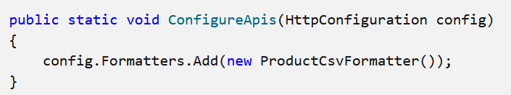
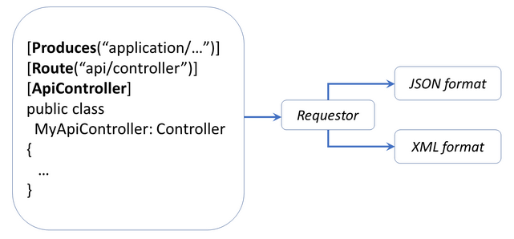
Media Formatter with Web API Pipeline
Adding a Media Formatter to the Web API Pipeline

Slide 8
Media Formatter
The media type determines how Web API serializes and deserializes the HTTP message body. Web API has built-in support for XML, JSON, BSON, and form-urlencoded data, and you can support additional media types by writing a media formatter.
To create a media formatter, derive from one of these classes:
MediaTypeFormatter. This class uses asynchronous read and write methods.
BufferedMediaTypeFormatter. This class derives from MediaTypeFormatter but uses synchronous read/write methods.

Slide 9
ASP.NET Web API MediaTypeFormatter - 1
The ASP.NET Web API MediaTypeFormatter is an abstract class from which the JsonMediaTypeFormatter and XmlMediaTypeFormatter classes are inherited. The JsonMediaTypeFormatter handles the JSON request and response where the XmlMediaTypeFormatter handles the XML request and response.
By default, the Web API framework supports two media types: JSON and XML.
When you issue a request with Accept: application/json, then the response message will be JSON and the Content-Type will be set to application/json.
Similarly, if you issue a request with Accept: application/xml, then the response message will be XML and the Content-Type will be set to application/xml.

Slide 10
ASP.NET Web API MediaTypeFormatter - 2
You can also specify a quality value indicating the relative preference. The range is 0–1, with 0 being unacceptable and 1 being the most preferred. The default value is 1.
For example, consider the below header
Accept: application/json; q=0.8, application/xml;q=0.9
Here, the response message will be in XML format because the application/xml has a quality value of 0.9, which is higher than the quality value of 0.8 specified for application/json.

Slide 11
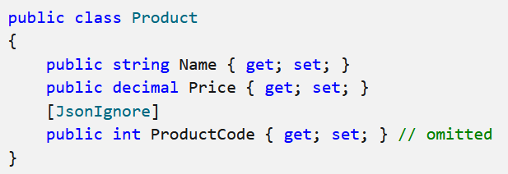
JSON Media-Type Formatter
JSON formatting is provided by the JsonMediaTypeFormatter class. By default, JsonMediaTypeFormatter uses the Json.NET library to perform serialization. Json.NET is a third-party open source project.
By default, all public properties and fields are included in the serialized JSON. To omit a property or field, decorate it with the JsonIgnore attribute.
Notes:
https://github.com/JamesNK/Newtonsoft.Json

Slide 12
XML Media-Type Formatter
XML formatting is provided by the XmlMediaTypeFormatter class. By default, XmlMediaTypeFormatter uses the DataContractSerializer class to perform serialization.
The XmlSerializer class supports a narrower set of types than DataContractSerializer, but gives more control over the resulting XML. Consider using XmlSerializer if you need to match an existing XML schema.

Slide 13
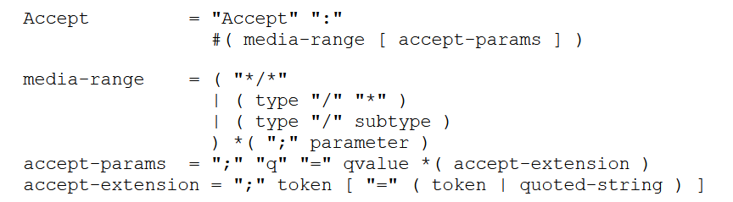
Header Field Definitions - HTTP/1.1
The Accept request-header field can be used to specify certain media types which are acceptable for the response. Accept headers can be used to indicate that the request is specifically limited to a small set of desired types, as in the case of a request for an in-line image.
Notes:
https://www.w3.org/Protocols/rfc2616/rfc2616-sec14.html

Slide 14
Format-specific Action Results
ASP.NET Core MVC has support for formatting response data. Response data can be formatted using specific formats or in response to client requested format.
Some action result types are specific to a particular format, such as JsonResult and ContentResult. Actions can return results that are formatted in a particular format, regardless of client preferences.
In the case, returning JsonResult returns JSON-formatted data. Returning ContentResult or a string returns plain-text-formatted string data.
ASP.NET Core supports any object return value. Results from actions that return objects that are not IActionResult types are serialized using the appropriate IOutputFormatter implementation.

Slide 15
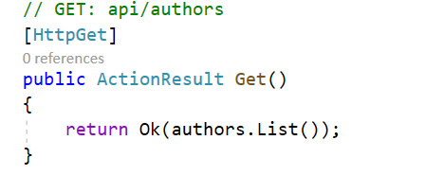
JSON-formatted data
The built-in helper method Ok returns JSON-formatted data
The response header containing content-type: application/json; charset=utf-8 is displayed.
The request headers are displayed. The Accept header is ignored by the preceding code.

Slide 16
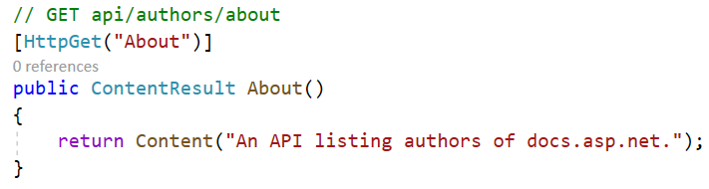
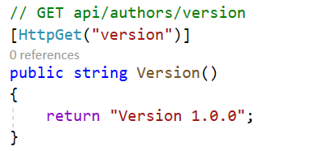
Plain text formatted data
To return plain text formatted data, use ContentResult and the Content helper
For actions with multiple return types, return IActionResult. Returning different HTTP status codes based on the result of operations performed.

Slide 17
Custom formatters in ASP.NET Core Web API
To create a custom formatter
For serializing data sent to the client, create an output formatter class.
For deserializing data received from the client, create an input formatter class.
Add instances of formatter classes to the InputFormatters and OutputFormatters collections in MvcOptions.
How to create a custom formatter class
Derive the class from the appropriate base class. The sample app derives from TextOutputFormatter and TextInputFormatter.
Specify valid media types and encodings in the constructor.
Override the CanReadType and CanWriteType methods.
Override the ReadRequestBodyAsync and WriteResponseBodyAsync methods.

Slide 18
Serialization In Web API With ASP.NET Core
The Web API serializes all the public properties into JSON. In the older versions of Web API, the default serialization property was in PascalCase. When we are working with .NET based applications, the casing doesn’t matter. But when the API is consumed by another application, such as Angular JS or any other application, then most of the cases are CamelCase as per the JavaScript standard. Moreover, most of the developers are familiar with this type of naming.
ASP.NET Core becomes the camelCase serialization as default. If we have migrated the application from Web API 2.0 to .NET core, the application may not be working. However, we can configure the serialization to PascalCase.

Slide 19
JSON serialization and deserialization
The System.Text.Json namespace provides functionality for serializing to and deserializing from JavaScript Object Notation (JSON).
The library design emphasizes high performance and low memory allocation over an extensive feature set. Built-in UTF-8 support optimizes the process of reading and writing JSON text encoded as UTF-8, which is the most prevalent encoding for data on the web and files on disk.
The library also provides classes for working with an in-memory document object model (DOM). This feature enables random read-only access of the elements in a JSON file or string.

Slide 20
Configure JSON Serialization in ASP.NET Core
The recommended approach is to use the default serialization that is delivered with ASP.NET Core. To configure it, locate the ConfigureServices method and update it by adding the code.
public void ConfigureServices(IServiceCollection services)
{
services.AddControllersWithViews().AddJsonOptions(options
=> options.JsonSerializerOptions.PropertyNamingPolicy = null);
}
The first alternative approach is to maintain the property names casing globally, locate the ConfigureServices method (using Newtonsoft.Json.Serialization)
services.AddMvc().AddNewtonsoftJson(options =>
options.SerializerSettings.ContractResolver = new DefaultContractResolver());

Slide 21
BSON Serialization - 1
BSON is a binary serialization format. "BSON" stands for "Binary JSON", but BSON and JSON are serialized very differently. BSON is "JSON-like", because objects are represented as name-value pairs, similar to JSON. Unlike JSON, numeric data types are stored as bytes, not strings
BSON was designed to be lightweight, easy to scan, and fast to encode/decode.
BSON is comparable in size to JSON. Depending on the data, a BSON payload may be smaller or larger than a JSON payload. For serializing binary data, such as an image file, BSON is smaller than JSON, because the binary data is not base64-encoded.

Slide 22
BSON Serialization - 2
BSON documents are easy to scan because elements are prefixed with a length field, so a parser can skip elements without decoding them.
Encoding and decoding are efficient, because numeric data types are stored as numbers, not strings.
To enable BSON serialization in ASP.NET Core Web API
using WebApiContrib.Core.Formatter.Bson;
…
public void ConfigureServices(IServiceCollection services)
{
….
services.AddMvc().AddBsonSerializerFormatters();
}

Slide 23
What is content negotiation
Content negotiation is a mechanism that can be used to serve different representations of the same resource at a given URI, providing ability to their clients to decide the best suited representations.
So, resource at given URI is basically an action in an API controller. Different representations can be XML representation, Json representation, etc. Client is any program that calls the resource (i.e. API action).
A client can be a browser, or postman or any other tool or program.

Slide 24
Content Negotiation
The primary mechanism for content negotiation in HTTP are these request headers such as Accept, Accept-Charset, Accept-Encoding, Accept-Language.
Accept: Which media types are acceptable for the response, such as "application/json," "application/xml," or a custom media type such as "application/vnd.example+xml"
Accept-Charset: Which character sets are acceptable, such as UTF-8 or ISO 8859-1.
Accept-Encoding: Which content encodings are acceptable, such as gzip.
Accept-Language: The preferred natural language, such as "en-us".

Slide 25
How Content Negotiation Works
First, the pipeline gets the IContentNegotiator service from the HttpConfiguration object. It also gets the list of media formatters from the HttpConfiguration.Formatters collection.
Next, the pipeline calls IContentNegotiator.Negotiate, passing in:
The type of object to serialize
The collection of media formatters
The HTTP request
The Negotiate method returns two pieces of information:
Which formatter to use
The media type for the response
If no formatter is found, the Negotiate method returns null, and the client receives HTTP error 406 (Not Acceptable).

Slide 26
Return types and content negotiation
In .NET Core Web APIs, content negotiation works with ObjectResult return type. ObjectResult is derived from ActionResult.
So if the API action returns IActionResult, .NET Core automatically wraps the object using ObjectResult concrete implementation and thus content negotiation support is added for those actions.
If an API action is returning a POCO object, .NET core automatically encapsulates it within an ObjectResult, hence content negotiation still works.
As stated earlier, if ContentResult and JsonResult return types are used, .NET core does not encapsulate the response inside ObjectResult. Hence, content negotiation does not work with these return types.

Slide 27
Default Content Negotiator
Content negotiation occurs when the client specifies an Accept header. The default format used by ASP.NET Core is JSON. Content negotiation is:
Implemented by ObjectResult.
Built into the status code-specific action results returned from the helper methods. The action results helper methods are based on ObjectResult.
When a model type is returned, the return type is ObjectResult.
By default, ASP.NET Core Web API returns a JSON formatted result (Also supports application/json, text/json, and text/plain media types).

Slide 28
Browsers vs Non-Browser Clients
Browsers generally specify multiple MIME types in accept header. They may also specify wildcards. The default behavior from any .NET core web application is :
Accept header coming from browser is ignored – if it is not configured to do otherwise
Response is always returned in JSON format
Non-browser clients may not have general HTTP standards implemented. Generally a web API can have non-browser clients e.g. phone app, desktop app, PowerShell script, etc. – which might send a specific MIME type in accept header that works best for them.

Slide 29
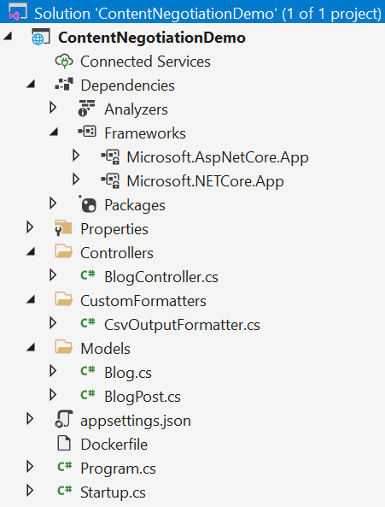
Implement Content Negotiation - 1
Implement Content Negotiation in ASP.NET Core Web API
Step 1. Create ASP.NET Core Web API Project

Slide 30
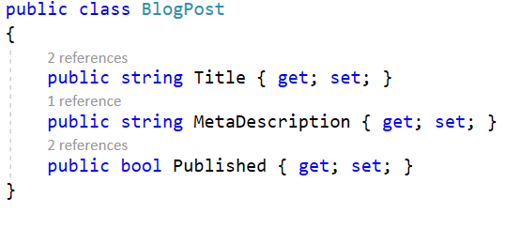
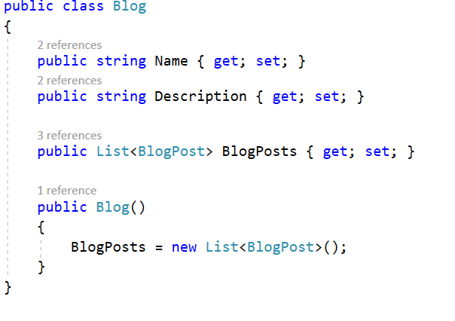
Implement Content Negotiation - 2
Step 2. Create Models

Slide 31
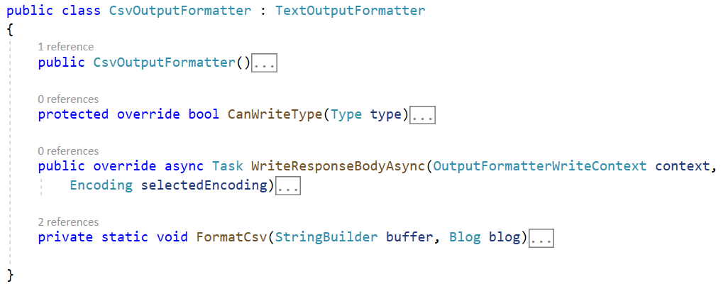
Implement Content Negotiation - 3
Step 2. Create Formatter class (extends TextOutputFormatter)

Slide 32
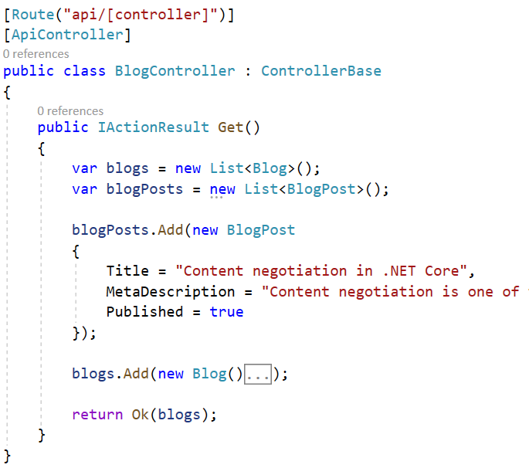
Implement Content Negotiation – 4
Step 3. Create ApiController

Slide 33
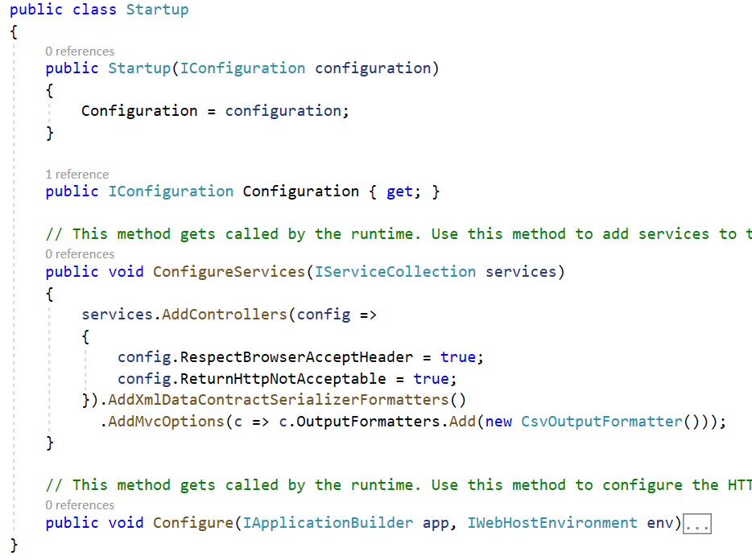
Implement Content Negotiation - 5
Step 4. Change the configuration service

Slide 34
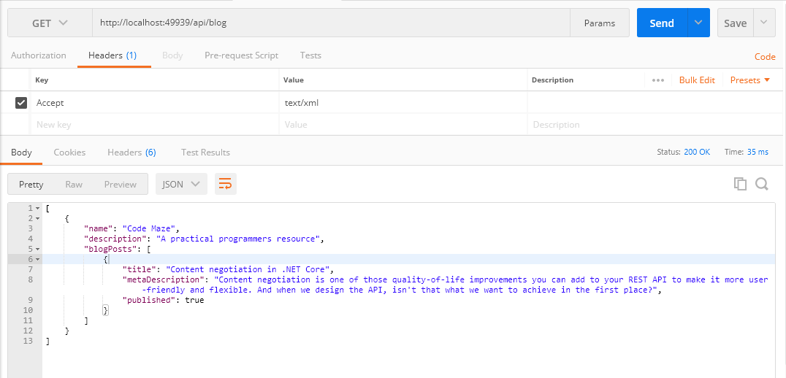
Implement Content Negotiation - 6
Step 5. Test the API using Postman.

Slide 35
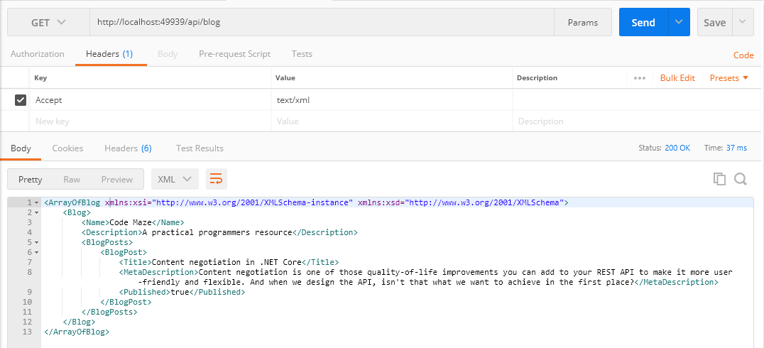
Implement Content Negotiation - 7
Step 5. Test the API using Postman with XML result.

Slide 36
Summary
The concepts were introduced:
Format response data
Media Formatters
Content Negotiation
Demo Content Negotiation with ASP.NET Core Web API

